Slide 1

Monitoring Environmental Pollution: A Microcontroller -Based Approach

Slide 2

POLLUTION DETECTING SYSTEM
Introducing a solution for environmental monitoring: our microcontroller-based pollution detecting system offers real-time detection and analysis of air, water and sound quality metrics. Designed for accuracy and efficiency, it provides crucial insights to mitigate pollution and safeguard public health.

Slide 3

CURRENT CHALLENGES
In Bangladesh, water pollution poses a significant threat as untreated industrial effluents and agricultural runoff contaminate rivers, jeopardizing access to clean water. Air pollution, largely attributed to vehicular emissions and industrial activities, plagues urban centers, exacerbating respiratory issues. Additionally, sound pollution from rapid urbanization and transportation disrupts daily life, contributing to stress and health concerns among the population.

Slide 4
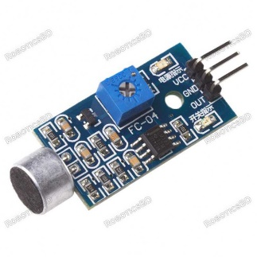
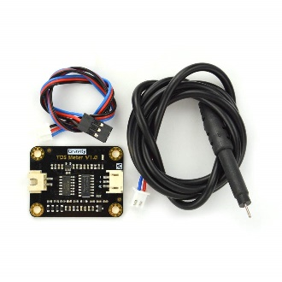
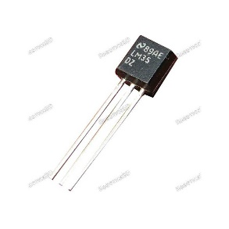
COMPONENT LIST (proposed)
ATmega32
ATmega burner
Breadboard
Resistor
Capacitor
Wires
LED
Push button
MQ-135 sensor
pH sensor
Temperature sensor
TDS sensor
Sound sensor
Sound sensor
TDS Sensor
Temperature Sensor

Slide 5
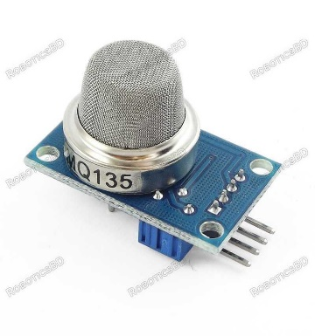
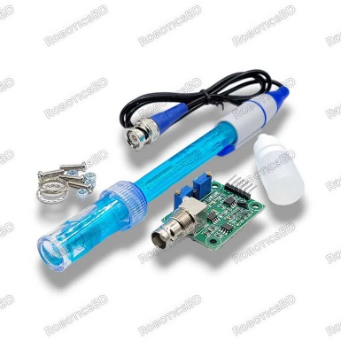
FEATURES
Detect the TDS level, pH level and temperature of
the sample water
Detect noise level of surrounding environment
Identify the harmful substances present in air
Show real time data in the system
Compare with ideal scenario and will give a
feedback
Warn about pollution
MQ – 135 sensor
pH sensor

Slide 6
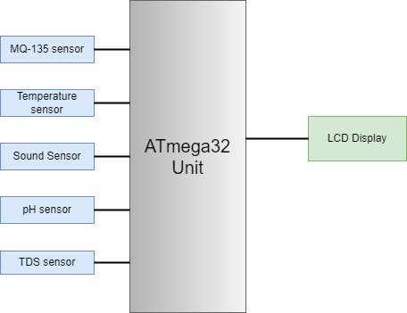
BLOCK DIAGRAM

Slide 7

Thanks!
Sadnam Faiyaz - 2005111
Shahriar Kabir - 2005114
Sadia Afrin Sithi - 2005119

